Slide 1

Your Tech Bootcamp
Dsfs-ft-28 # Medical deserts

Slide 2

Group members
Claudine WENHAJI
Jean-David PELTIER
Alexandre CAPRARO

Slide 3
Project presentation
JD
What is a medical desert ?
A medical desert is a geographical area where the population encounters difficulties in accessing healthcare. The density of healthcare professionals or establishments, particularly doctors, is significantly lower than in the rest of the country, in relation to its population and needs.
How to identify them?
In order to identify these medical deserts, the French government has decided to introduce a statistical indicator: APL (Accessibilité Potentielle Localisée). APL measures the spatial match between supply and demand for primary care. In other words, it makes it possible to evaluate, for each commune and for a given year, the level of access to general practitioners for its inhabitants.
Project objectives
🎯Find demographic and socio-economic indicators about french cities
🎯Train a machine learning model to acknowledge which indicators or combination of indicators influence most the presence of medical deserts
🎯Use these indicators as levers in public policies in order to reduce the number of medical deserts

Slide 4
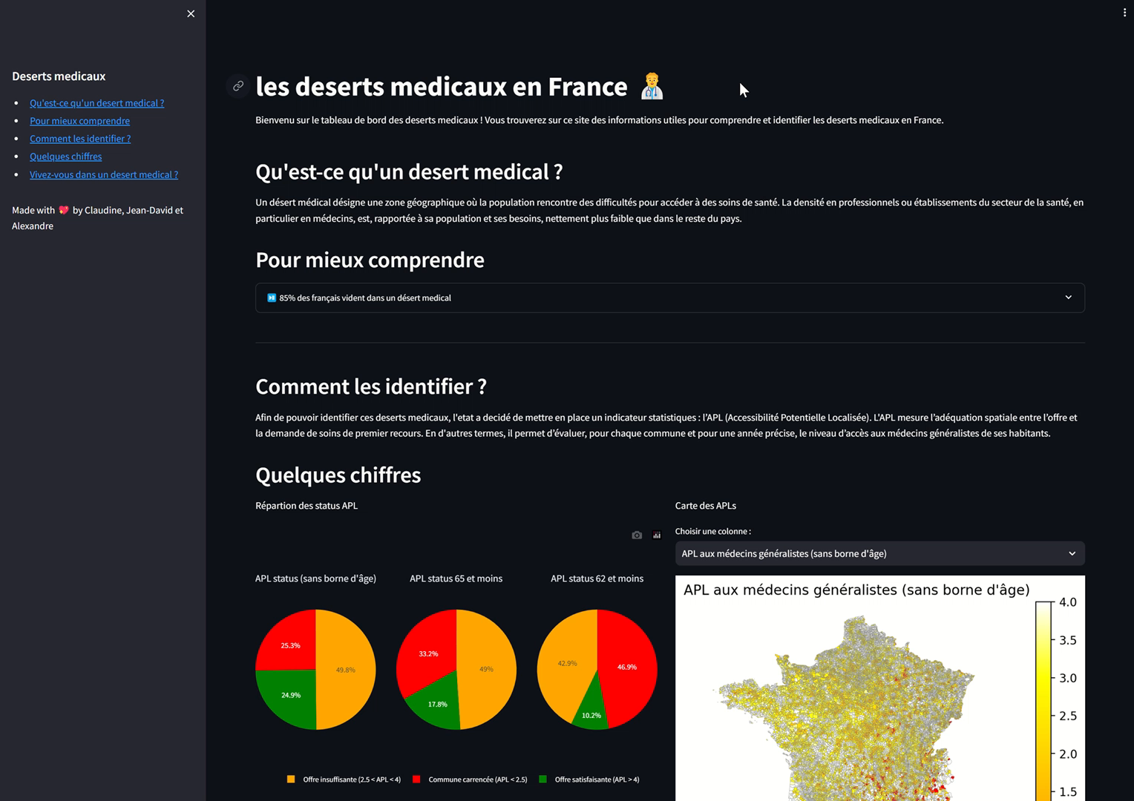
Medical deserts dashboard
Alex
Medical deserts application

Slide 5





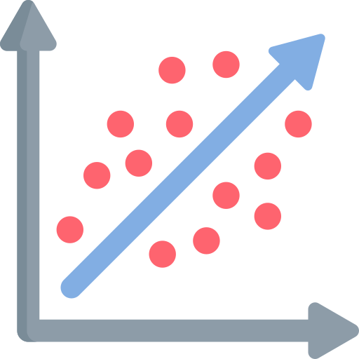
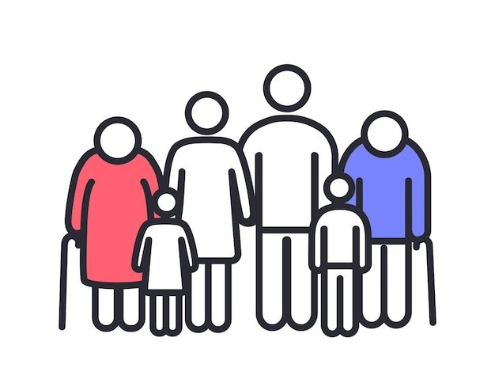
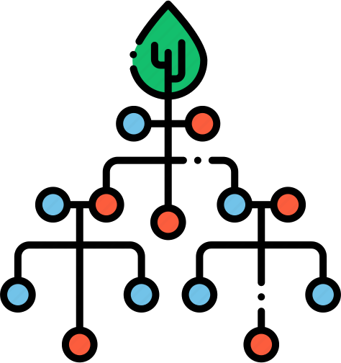


Dataset used
Alex
Cities administrative boundaries
https://adresse.data.gouv.fr/data/contours-administratifs/2021/geojson
Temp dashboard dataset
Final dashboard dataset
Online dashboard
APL
https://drees.shinyapps.io/carto-apl/
INSEE
https://www.data.gouv.fr/fr/datasets/data-insee-sur-les-communes/
Linear regession model
Population statistics
https://www.insee.fr/fr/statistiques/2862207
Temp machine learning dataset
Final machine learning dataset
Random forest model
Cities geo coordinates
https://www.data.gouv.fr/fr/datasets/villes-de-france/
Cities urbanisation
https://www.insee.fr/fr/statistiques/2862207

Slide 6
Linear regression model
JD & Alex
Basic model with the best correlated feature
Basic model with all features (best result)
Basic model by dropping correlated features (correlation matrix)
SequentialFeatureSelector with 10, 20 & 30 features to select
Non linear regression
Non linear regression with SequentialFeatureSelector
Very low scores
need to use another model

Slide 7
Random forest model
Claudine

Slide 8
Conclusion
Claudine

Slide 9
What’s next?
JD
X
Y
Z

Slide 10

Any questions ?

Slide 11
Your Tech Bootcamp
Jedha template

Slide 12
Pitch

Slide 13
Results

Slide 14
Results

Slide 15
Solution description

Slide 16
Solution description

Slide 17
What’s next?

